Slide 1
Lab Assignment #1
Comp 445 Fall 2020
Cristian Rodriguez

Slide 2
Plagiarism and code re-use
Any assignment code that is copied from anywhere on the Internet including and not limited to online code repos, such as Github and alike, and not clearly mentioned in the assignment and during the demo will receive an absolute ZERO.
If the code is copied from a group other than your own group, then both groups will be subject to a severe penalty.
Always write your own unique code and ensure to include any citations wherever needed.

Slide 3
Plagiarism and code re-use
Citations don’t mean that you can include any code as long as you cite them!

Slide 4
Usability
Lab Assignment #1
Implement a simple HTTP client and experiment it in real HTTP Servers.
Lab Assignment #2
Implement a simple HTTP server and experiment it with the previous developed HTTP client.
Lab Assignment #3
Re-implement the HTTP client and the HTTP server from the previous assignments using UDP protocol.
Lab Assignment #4
Selective Repeat (ARQ)

Slide 5
Environment setup
Java Socket library.
Choose an operating system.
Choose your favorite IDE (Netbeans, Eclipse, etc.)
Choose a code version control system. (Git)
The environment could be setup on a physical machine, virtual machine, or container machine.

Slide 6

Virtual machine
VirtualBox

Slide 7

Git

Slide 8

Wireshark
Packet Analyzer.
Network troubleshooting.
Ubuntu: sudo apt install wireshark
https://www.wireshark.org

Slide 9
Wireshark
Display filter examples:
Show only traffic which IP source is 192.168.1.1
ip.src == 192.168.1.1
Show TCP or UDP packets with a TCP or UDP source or destination port.
tcp.port == 80 || udp.port == 80
Show only HTTP GET request
http.request.method == “GET”
Show only HTTP traffic
http
Learn more about display filters: https://wiki.wireshark.org/DisplayFilters

Slide 10
Wireshark
Why is it useful?
Debug TCP 3-way handshake.
Make sure that you are sending bytes in the right order (big endian or little endian).

Slide 11
HTTP Protocol
Application Layer
HTTP GET
HTTP POST
Use HTTP version 1.0 due to its simplicity and ease to implement.
Presentation Layer
Session Layer
Transport Layer
Network Layer
https://www.w3.org/Protocols/HTTP/1.0/spec.html
Data Link layer
Physical Layer

Slide 12
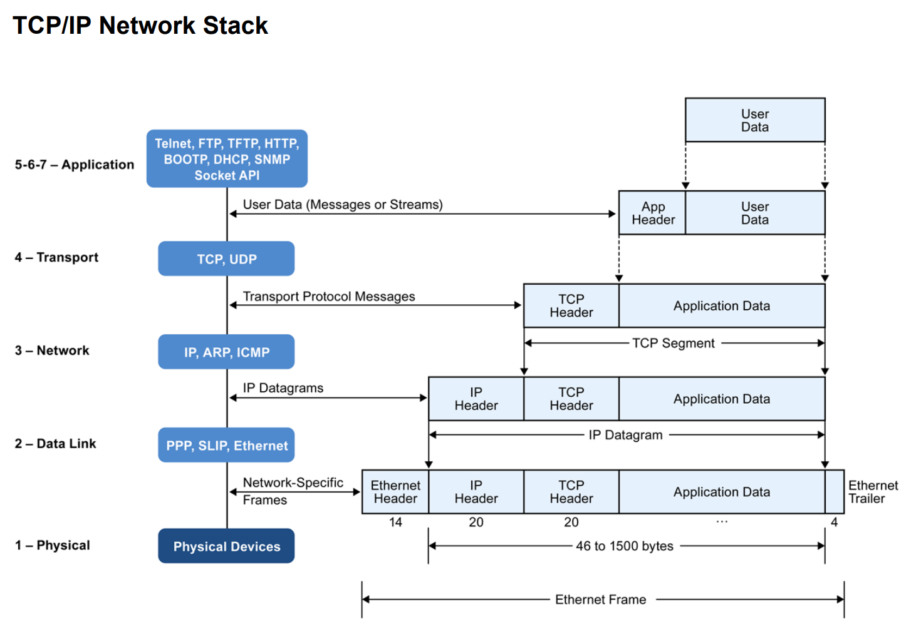
HTTP Protocol
http://webpages.eng.wayne.edu/~fy8421/16sp-csc5991/labs/lab1-instruction.pdf

Slide 13
HTTP Client library Implementation
Use Java TCP Sockets.
Features:
GET Operation
POST Operation
Query parameters
Request headers
Body of the request

Slide 14
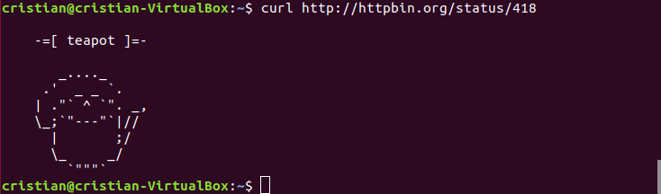
Command line Implementation
Built a simple HTTP client using your library.
Command line:

Slide 15
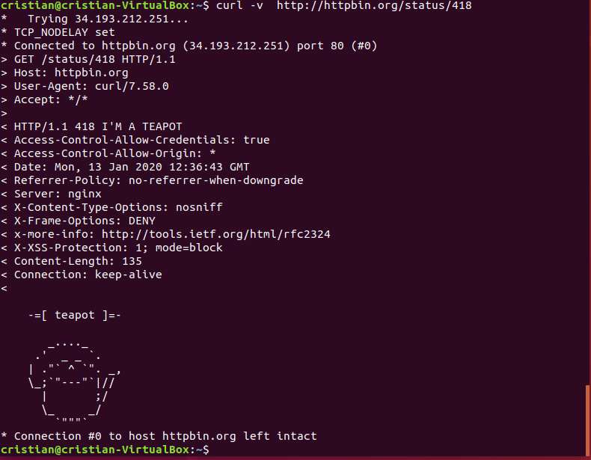
cURL-like Command line Implementation
Built a simple HTTP client using your library.
cURL command line:

Slide 16
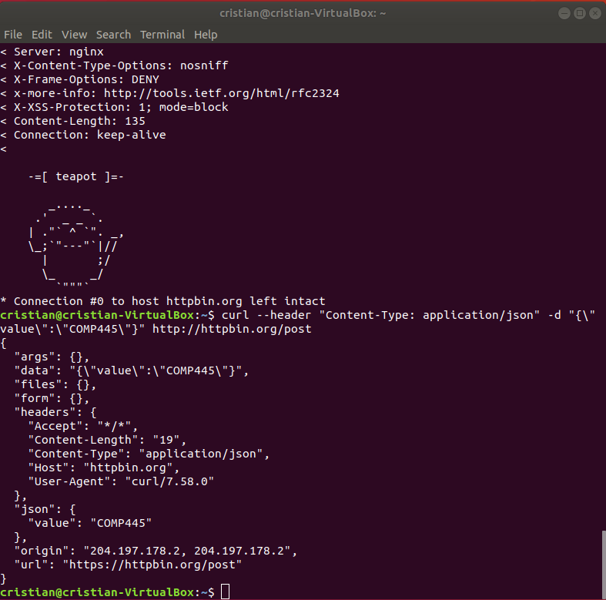
Command line Implementation
Built a simple HTTP client using your library.
Command line:
-- header
Content-type
-d
Post body content

Slide 17
Command line Implementation
Built a simple HTTP client using your library.
httpc (get|post) [-v] (-h "k:v")* [-d inline-data] [-f file] URL
-v verbose output from the command-line.
URL determines the target HTTP server.
-h To pass the headers.
-d associates the body of the HTTP Request with the inline data.
-f similar to -d but from a text file.
get/post
POST should have either –d or –f but not both.
GET should not used –d or –f.

Slide 18
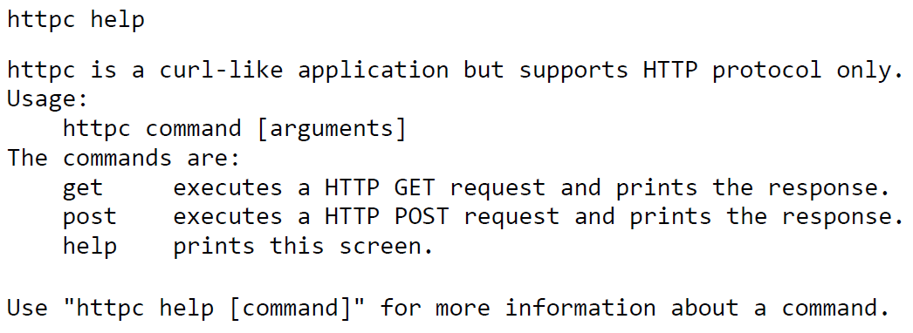
Command line Implementation

Slide 19
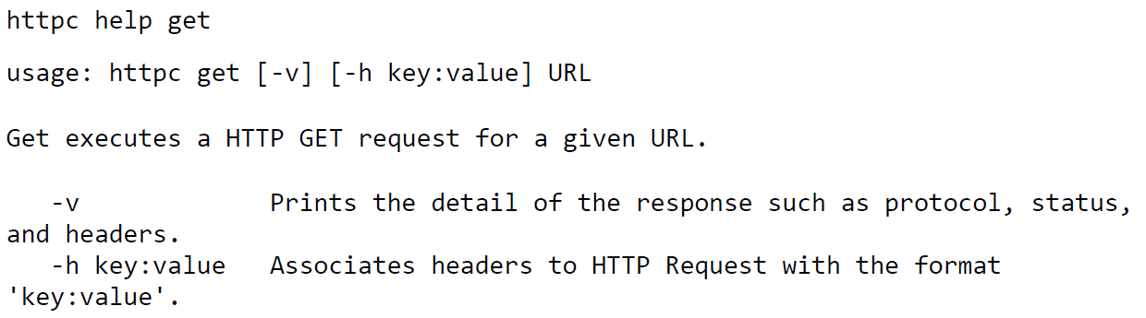
Command line Implementation

Slide 20
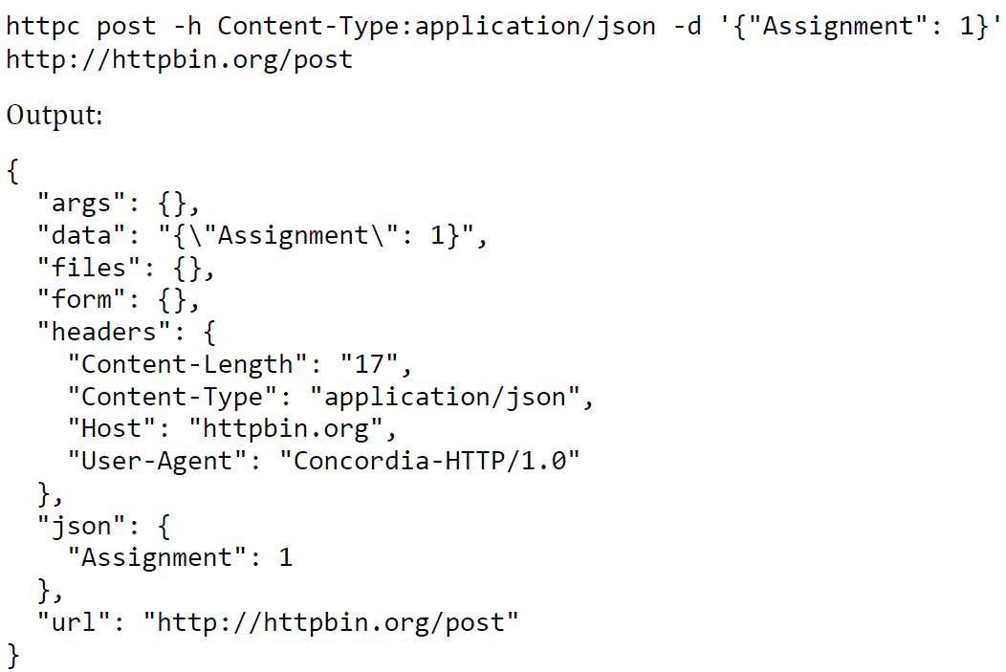
Command line Implementation

Slide 21
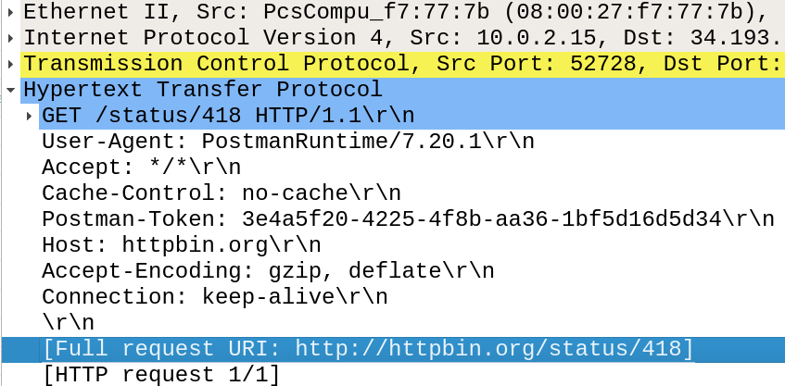
HTTP Request
Request-line
Method
Request-URI
Protocol Version
Request Header Fields

Slide 22
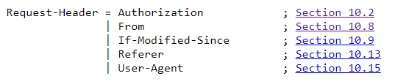
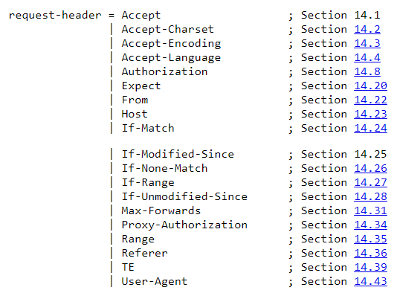
HTTP Request Request Header Fields v1.0 VS 1.1

Slide 23
Request header fields v1.0
Authorization
Consists of credentials containing the authentication information of the user agent.
From
If given, should contain an Internet e-mail address for the human user who controls the request.
If-Modified-Since
If it is used, then GET request is conditional.
If the requested resource had not been modified since the time specified in this field, a copy of the resource will not be returned from the server. Instead, a 304 (not modified) response will be returned.

Slide 24
Request header fields v1.0
Referer
The address (URI) of the resource from which the request URI was obtained.
User-Agent
Information about who is originating the request.

Slide 25
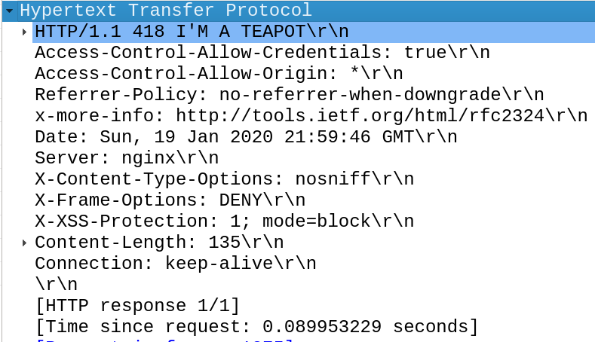
Response
Status line
Protocol Version.
Status code.
3-digit result code.
Textual phrase.
Short textual description

Slide 26
Response
Status line
Response Header fields
Location
Server
WWW-Authenticate
Entity
Allow
Content-Encoding
Content-Length
Content-Type
Expires
Last-Modified

Slide 27
Response
Response Header fields
Location: exact location of the resource that was identified by the URI. (300)
Server: Information about the software used by the origin server to handle the request.
WWW-Authenticate: Consist of at least one challenge that indicates the authorization scheme (401)
Entity
Allow: set of methods supported by the resource identified by the URI.
Content-Encoding: Used to know what decoding mechanism must be applied.
Content-Length: Size of the body.
Content-Type: Content type.
Expires: Gives the date/time after which the entity should be considered stale.
Last-Modified: When the resource was last modified.

Slide 28
Wireshark HTTP lab
Taken from:
Supplement to Computer Networking: A Top-Down Approach, 7th ed., J.F. Kurose and K.W. Ross.
V7.0

Slide 29
Wireshark HTTP lab
Perform a basic GET request from a web browser.
Is your browser running HTTP version 1.0 or 1.1?
What version of HTTP is the server running?
What languages (if any) does your browser indicate that it can accept to the server?
What is the IP address of your computer?
What is the IP address of the server?
What is the status code returned from the server?
How many bytes of content are being returned to your browser?
http://postman-echo.com/get?foo1=bar1&foo2=bar2

Slide 30
POST Example
http://postman-echo.com/post
Send data to the server:
Query String parameters.
Request body.
Set Content-Type with:
multipart/form-data
application/x-www-form-urlencoded
application/json

Slide 31
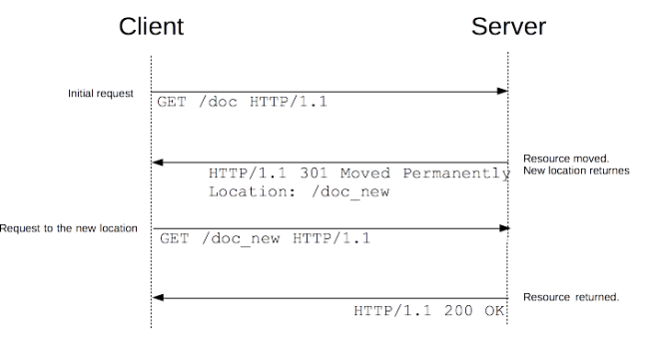
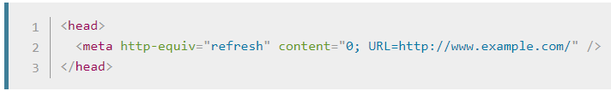
How does redirection work?
https://developer.mozilla.org/en-US/docs/Web/HTTP/Redirections

Slide 32
Grading Policy
HTTP Library:
Connectivity: 3 marks
Design and Reusability: 1 mark
Get request: 1 mark
Post request: 1 mark
Parsing (of response and commands): 1 mark.
Curl-like app
Get command: 0.5 marks
Post command: 0.5 marks
Verbose: 0.5 marks
Header: 0.5 marks
Inline: 0.5 marks
File: 0.5 marks
Optional:
Supports redirect: 1.5 marks
Supports –o option: 0.5 marks

